Slide 1



A.D. PATEL INSTITUTE OF TECHNOLOGY
COURSE
:PROGRAMMING WITH PYTHON
BRANCH
:Information Technology (IT-A)
PRESENTED BY:
PROJECT
DEFINITION
Duplicate Photo anf file finder
    RAJ ANIRUDDH N
(12402080601004)

Slide 2
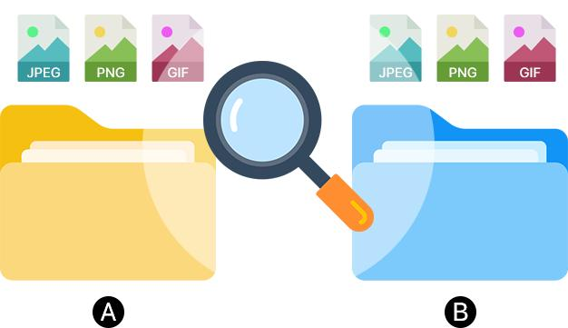
The Problem of Duplicate Photos and Files
  Duplicate files are often created when copying, downloading, or sharing files.
  Multiple copies waste valuable storage space.
  Manually finding duplicate files is time-consuming.
  Files may have different names but contain exactly the same data.
  Deleting files without checking can lead to accidental data loss.
Our Solution: A Python-based desktop application that scans a selected folder and identifies duplicate files by comparing their file size and SHA-256 hash.

Slide 3
Objectives and Tools Used
  Objectives
  Detect duplicate files automatically.
  Reduce unnecessary storage usage.
  Apply algorithmic techniques to compare files.
  Display duplicate groups through a graphical interface.
  Analyze the algorithm's time and space requirements.
  Technologies
  Python: Implementation language.
  Tkinter: Desktop graphical interface, if used in your implementation.
  File handling: Scans folders and reads file information.
  SHA-256: Generates a digital fingerprint of file contents.
02
05

Slide 4
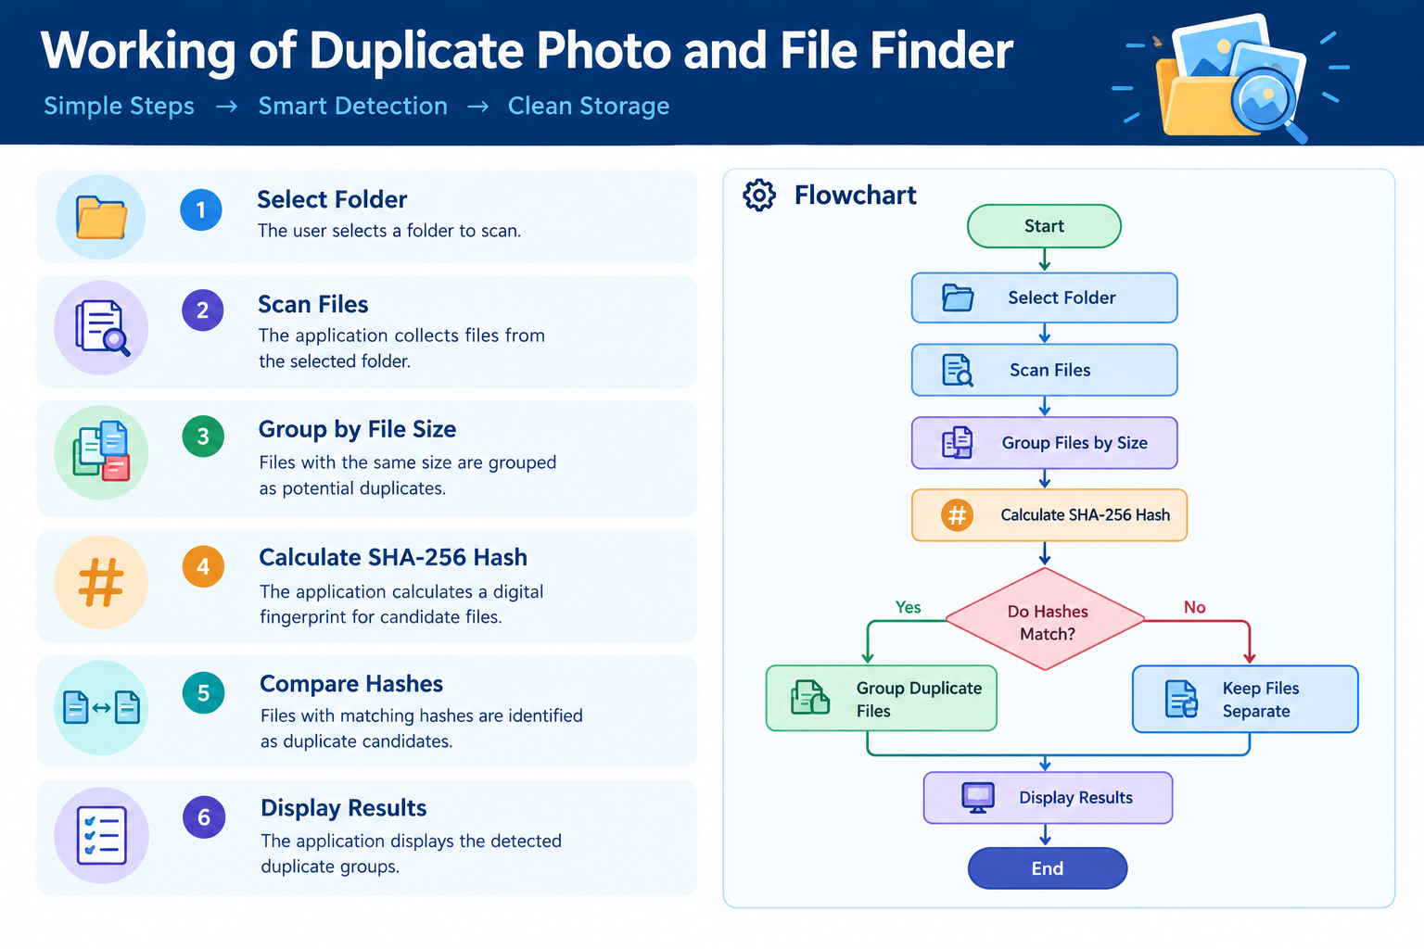

Slide 5
Algorithm Design
  Algorithm: Size Grouping and Hash Comparison
  Start the application and select a folder.
  Scan all files in the selected folder.
  Group files according to their file size.
  Select groups containing more than one file.
  Calculate the SHA-256 hash for each candidate file.
  Compare the hash values of the files.
  Group files with matching hashes as duplicates.
  Display the duplicate groups and stop.
  Key DAA concept: File-size filtering reduces unnecessary comparisons, while hashing helps identify files with identical contents.

Slide 6
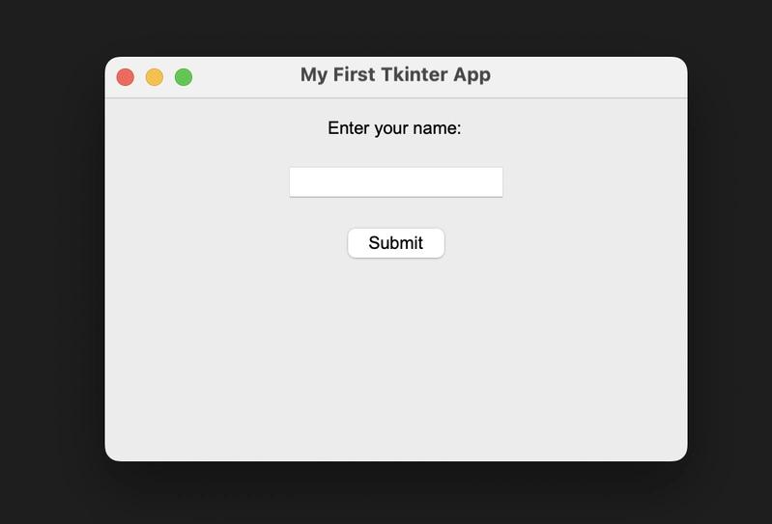
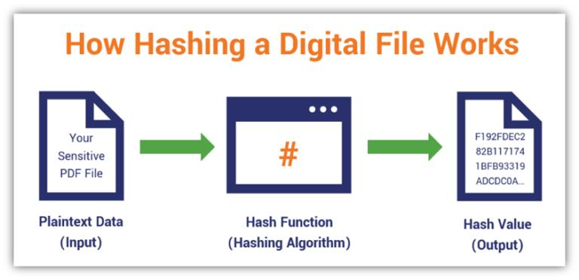
Python and Algorithm Concepts Used
  File Handling: Reads files and scans folders and subfolders.
  Dictionaries: Groups files by file size and SHA-256 hash.
  Hashing (SHA-256): Compares file contents to identify duplicate candidates.
  Algorithm Optimization: Checks file sizes first to reduce unnecessary hashing.
  Exception Handling: Handles errors such as inaccessible files.
  Threading: Runs scanning in the background to keep the interface responsive.
  GUI Programming (Tkinter): Provides a user-friendly desktop interface.

Slide 7
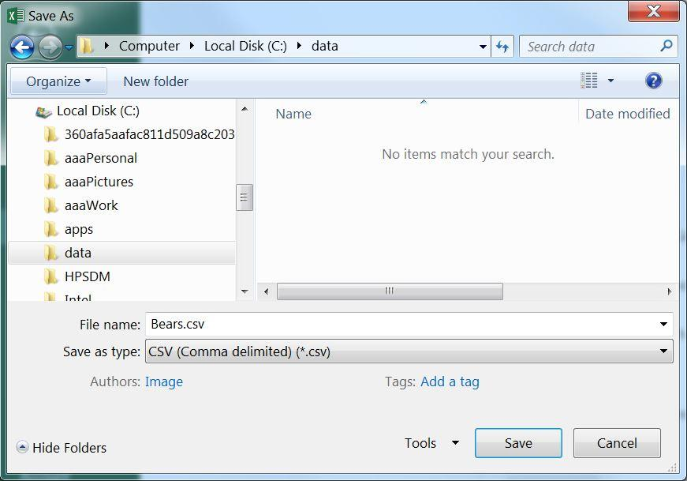
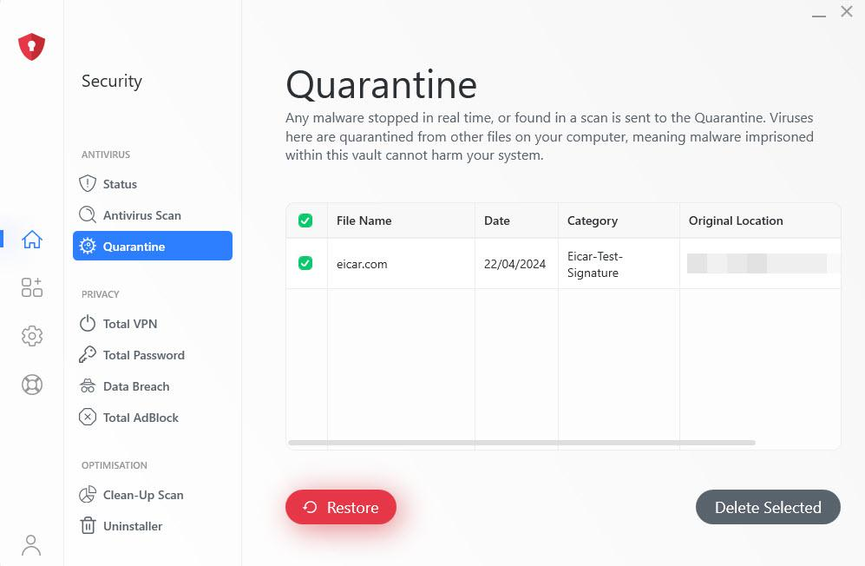
Main Features of Duplicate File Finder
  Folder Selection: Select any folder to scan.
  Recursive Scanning: Searches files inside subfolders.
  Duplicate Detection: Identifies duplicate candidates using file size and SHA-256 hashes.
  Progress Tracking: Shows scanning progress and supports cancellation.
  CSV Report Export: Saves duplicate file details for future reference.
  Quarantine Feature: Moves selected files to a quarantine folder instead of permanently deleting them.
  Error Handling: Handles inaccessible files and other file-operation errors.

Slide 8
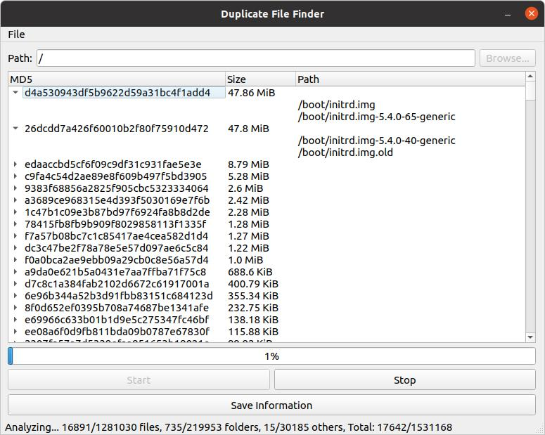
Testing and Results
  Duplicate File Test: Checks whether files with identical contents are identified.
  Different Content Test: Checks files with the same size but different contents.
  Folder Scanning Test: Verifies that files in subfolders are scanned.
  Empty Folder Test: Checks the application when no files are present.
  CSV Export Test: Verifies that duplicate information can be exported.
  Quarantine Test: Checks whether selected files are moved to the quarantine folder.

Slide 9
Advantages, Limitations and Future Scope
Advantages
  Saves time by automatically detecting duplicate files.
  Helps organize files and manage storage.
  Uses SHA-256 hashing for content-based comparison.
  Provides CSV reports and safer file quarantine.
Limitations
  Scanning large folders may take time.
  Inaccessible files may not be processed.
  It detects identical file contents, not visually similar images.
Future Scope
  Add a restore option for quarantined files.
  Add image previews and file-type filters.
  Improve reporting and scanning performance.

Slide 10
Conclusion
  Developed a desktop application using Python.
  Uses file size and SHA-256 hashing to identify duplicate file candidates.
  Uses Tkinter to provide a graphical user interface.
  Supports CSV report export and file quarantine.
  Demonstrates practical Python programming concepts.

Slide 11
Thank You

